Slide 1
A Tail of Two Segments
CS195: Computer Vision
December 11, 2024
Cooper Brown, Jack Welsh, Morgan Bergstrom, Ryan Nash, Zakir Naqvi

Slide 2
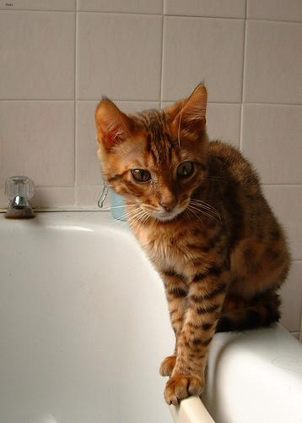
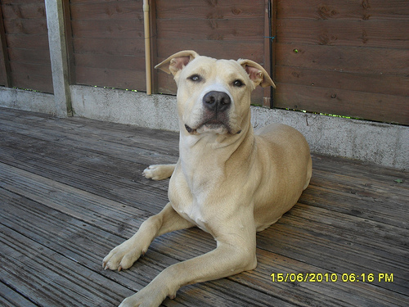
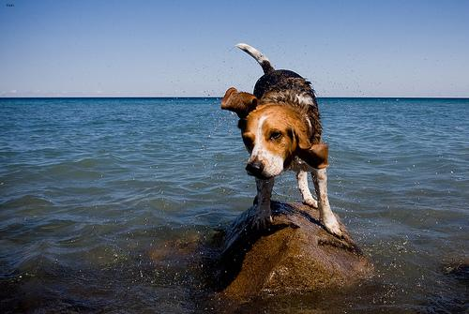
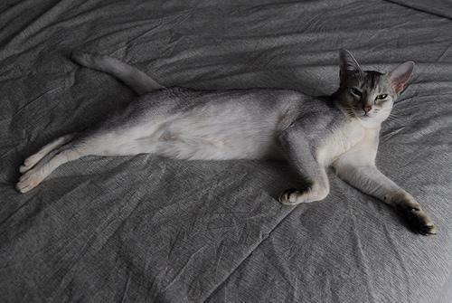
Problem Statement
Developing computer vision models capable of accurately segmenting two different categories: dog and cat.
The model should effectively segment these two animal species, even in challenging scenarios such as variations in lighting, pose, and background clutter.

Slide 3
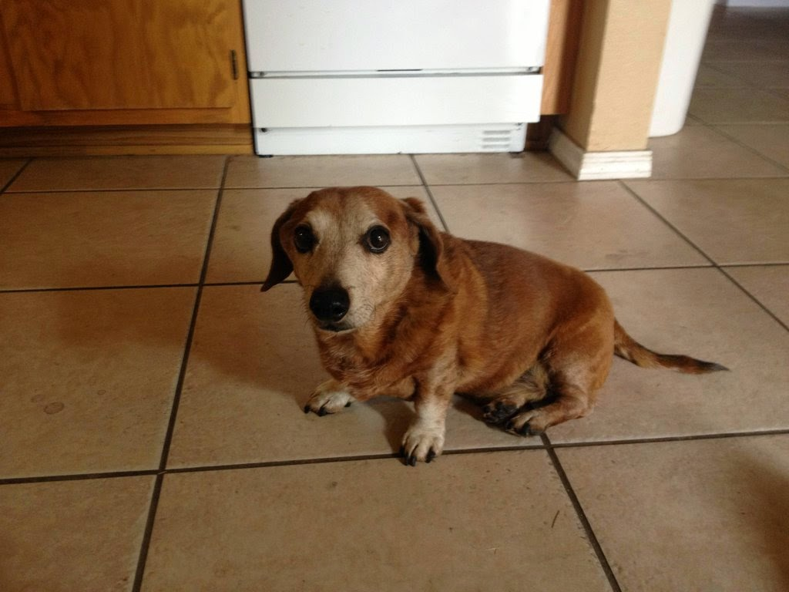
Usages
Pet-Focused Image Editing Software
Pet Insurance Claims Processing
Animal Welfare and Rescue Efforts

Slide 4
Approach
Try 4 different semantic segmentation models on the same dataset and see how they perform in numerous tests
Models
HRNet
SegNet
UNet
Masked2Former

Slide 5
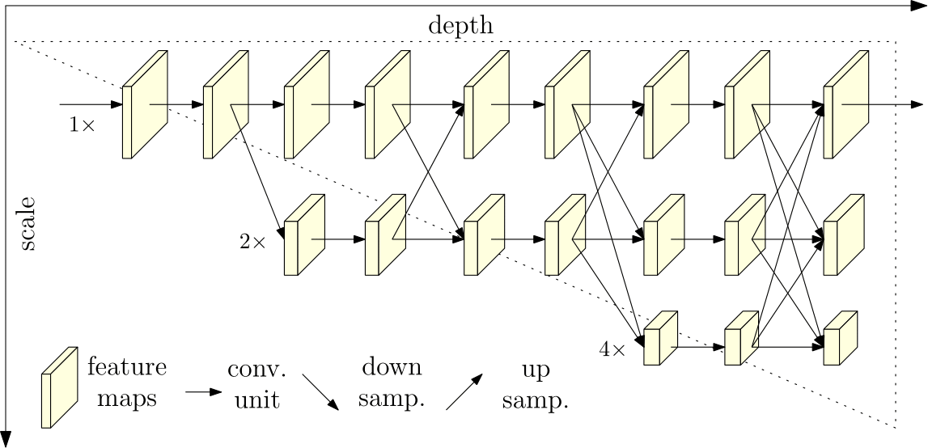
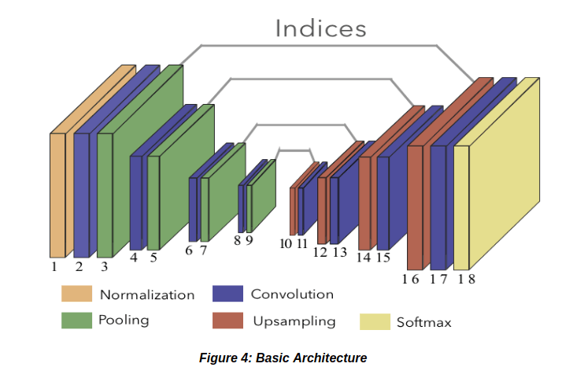
The models we used were
HRNet- HRNet maintains high-resolution representations throughout the entire network, leading to better feature representation and localization accuracy.
SegNet- SegNet is an encoder-decoder architecture that leverages pooling indices from the encoder to perform upsampling in the decoder, reducing the need for learning upsampling filters.

Slide 6

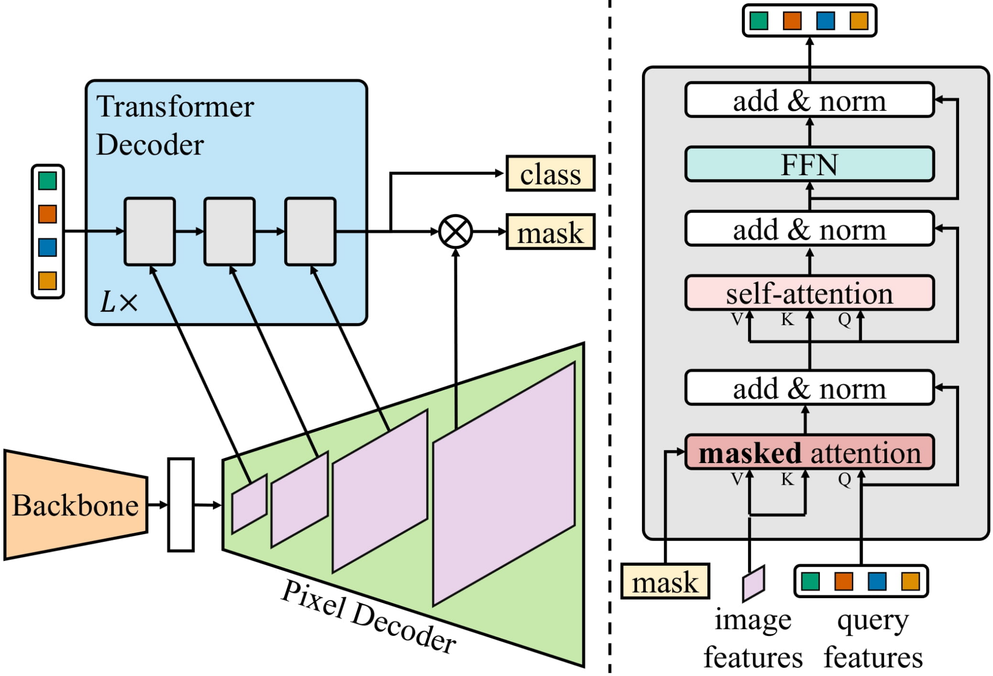
The models we used were
UNet- UNet is a popular architecture for image segmentation tasks, characterized by its U-shape. It efficiently captures context information from deeper layers and combines it with detailed information from shallower layers.
Masked2Former- Masked2Former is a novel vision transformer architecture that combines the strengths of masked image modeling and dense prediction. It treats image segmentation as a sequence-to-sequence prediction task, where the model predicts the segmentation mask for each pixel.
Our implementation used Resnet152 as a backbone

Slide 7
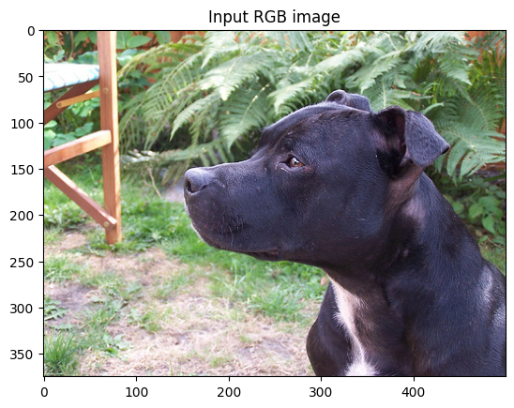
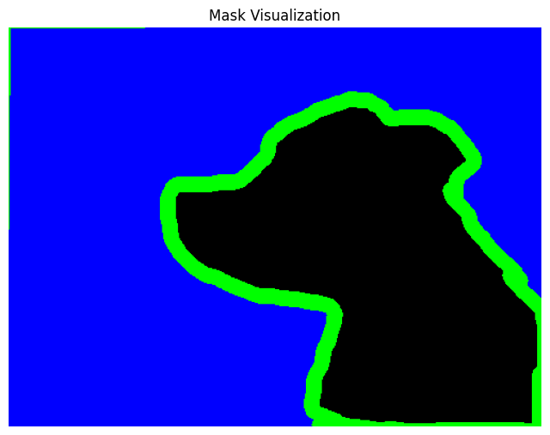
Dataset
The Oxford-IIIT Pet Dataset
7,349 Annotated Images of Cats and dogs
We used ~3000 images of the dataset with their annotations

Slide 8
How we split up our dataset
Dogs
~1200 Number of pictures trained on
~300 Number of pictures tested on
Cats
~1200 Number of pictures trained on
~300 Number of pictures tested on

Slide 9
Results of our Networks

Slide 10
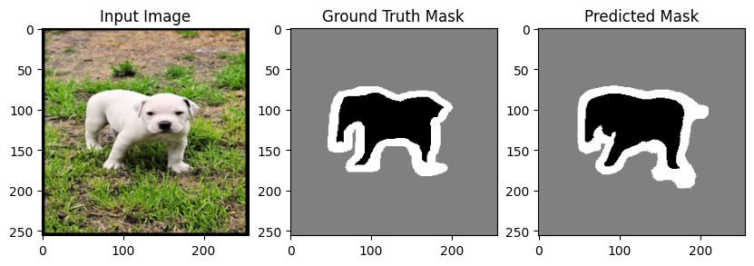
U-Net
The UNet network after 47-50 epochs was at its lowest loss and its prediction was ~80% accurate average.

Slide 11
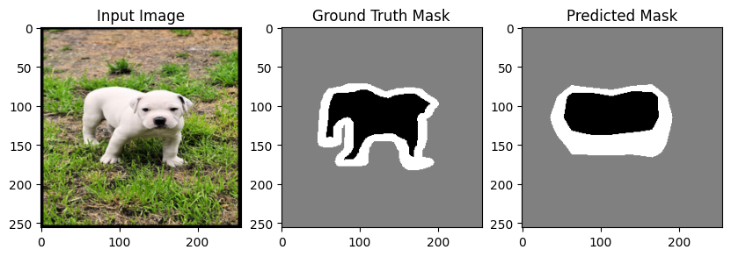
Masked2Former
Trained for 100 Epochs
Around 78% accurate per pixel.

Slide 12
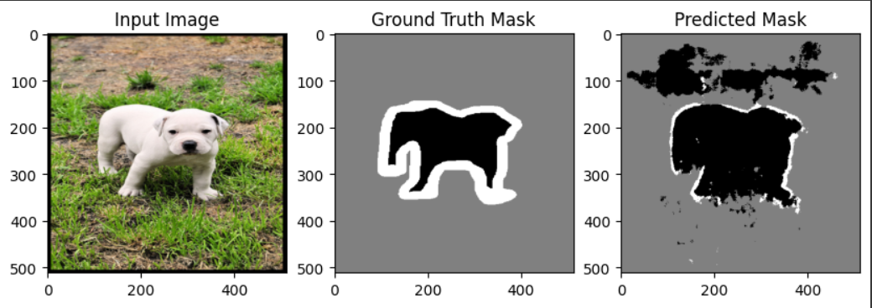
SegNet
SegNet trained on 10 epochs. Was ~ 60% corect

Slide 13
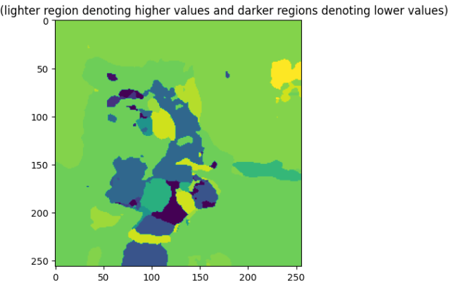
HRNet

Slide 14
Experiment 1
All of our models were trained on dog images
This experiment was to see how accurately a model trained on dog images can perform on cat images

Slide 15
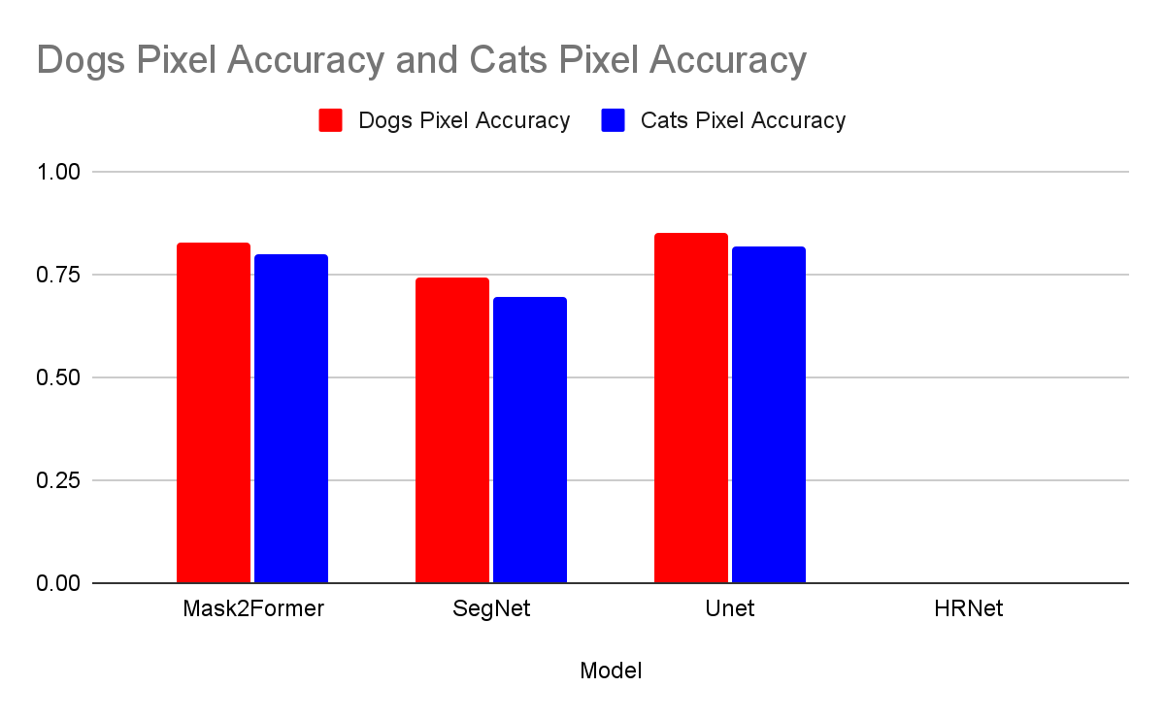
Experiment 1 Data

Slide 16
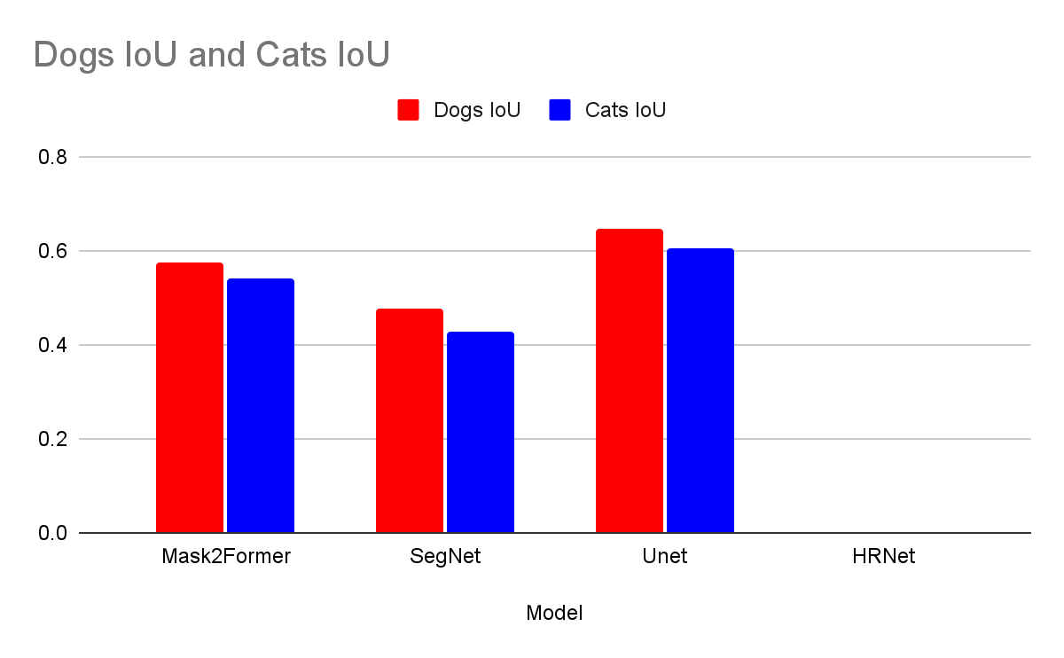
Experiment 1 Data

Slide 17
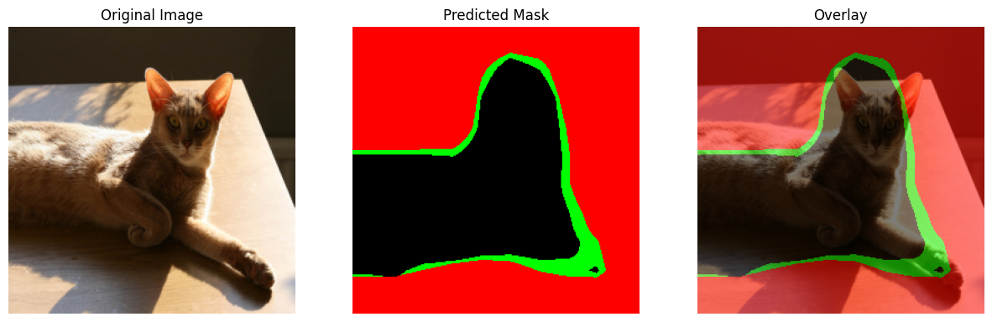
Masked Images over cats
MaskToFormer

Slide 18
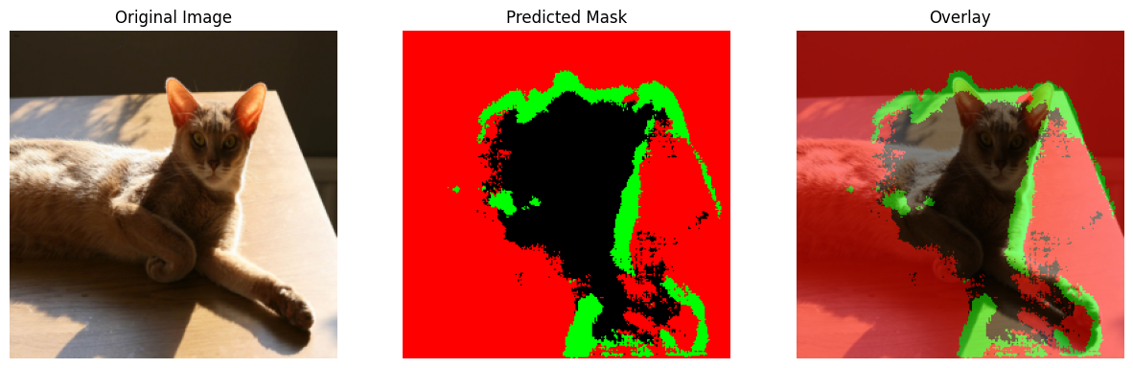
Masked Images over cats
SegNet

Slide 19
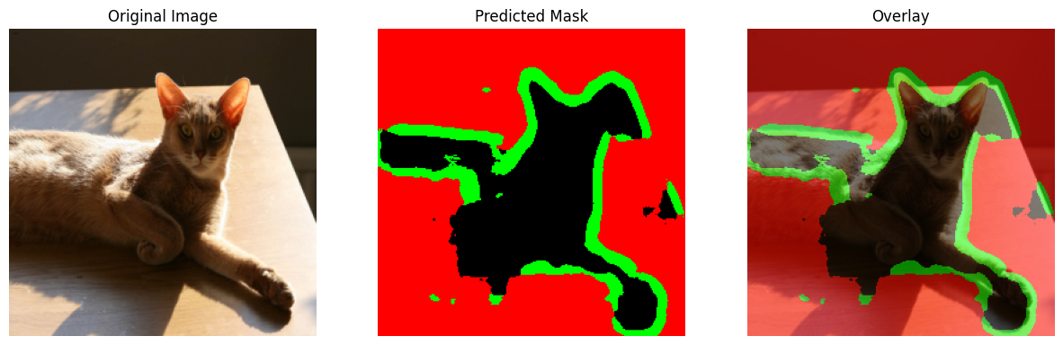
Masked Images over cats
UNet

Slide 20
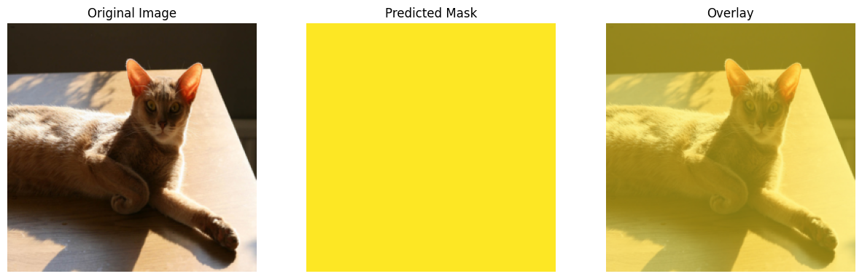
Masked Images over cats
HRNet

Slide 21
Experiment 1 Conclusions
Versatility: Mask2Former demonstrated the highest versatility, showing the lowest variance in performance between cat and dog images.
Overall Performance: UNet emerged as the best-performing model across all metrics. While SegNet performed the worst

Slide 22
Conclusion
In conclusion, we've successfully developed semantic segmentation networks that identify and delineate cats and dogs within images to different success.
By employing a different architecture, we learned the differences between the networks and the advantages of each.
Unet was by far the most effective, however mask2former was most versatile.

Slide 23
Questions?

Slide 24
Contribution
Morgan Bergstrom - UNet, Presentation- 25%
Cooper Brown- Mask2former, Experiment 1, Data preprocesing - 30%
Jack Welsh- ResNet- 20%
Ryan Nash- HRNet - 12.5%
Zakir Naqvi- Experiment 2 - 12.5%

Slide 25
Extra resources

Slide 26
SlidesCarnival icons are editable shapes.
This means that you can:
Resize them without losing quality.
Change fill color and opacity.
Isn’t that nice? :)
Examples:

Slide 27
Diagrams and infographics

